Slide 1
CLOUD ARMOUR:SUPPORTING REPUTATION BASED TRUST MANAGEMENT FOR PRIVATE CLOUD SERVICES
UNDER THE GUIDANCE OF:
MRS.R.DEVI
ASSISTANT PROFESSOR/IT,
GOVERNMENT COLLEGE OF TECHNOLOGY.
BY,
S.V.ANAMIGA(1318102)
R.JAYACHITRA(1318119)
S.KIRUTHIKA(1318124)
B.ROJA(1318136)

Slide 2
OBJECTIVE
The Primary objective of this project is to develop a trust aware routing environment using ESMTP server.
Here an email environment is developed for an organization.
For special security purpose here we introducing a latest method called as IDS (Intruder detection system), which identifies the third party intruder or hacker from other networks.

Slide 3
EXISTING SYSTEM
Guaranteeing availability of trust management service is a difficult problem.
Wrong type of service may be cho0sed.
collusion Attack :
This type of attacks occurs when several users collaborate together to increase or to decrease the trust result of cloud services.
Sybil Attack:
This type of attacks occurs when malicious users exploit multiple identities to give numerous misleading feedbacks for a self-promoting or slandering attack.

Slide 4
PROPOSED SYSTEM
To create secure cloud armor based organization and mail server using trust and aware routing.
Credibility and trust worthy of the users can be calculated according to the user behavior model.
The whole architecture has been implemented in a mail server.
User's feedback will taken as the suggestion model and user's confidential level can be calculated.
Intruder Detection System has been implemented
The result will prove that and enhanced cloud armor has been implemented.
Trust aware routing framework has been implemented for Privacy purpose
Aware routing framework has been implemented for Preservation purpose

Slide 5
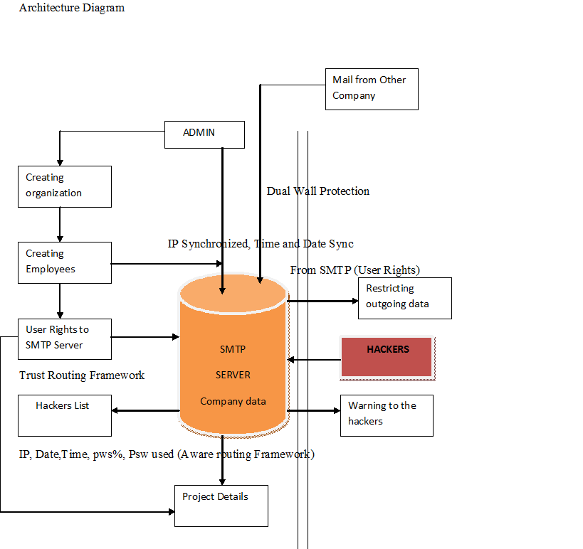
BLOCK DIAGRAM

Slide 6
MODULE IMPLEMENTATION
Creating Cloud Organization Environment
Configuring ESMTP.
Trust As A Service
Implementing Trust routing framework – For Privacy
Implementing Aware routing framework – For Preservation.

Slide 7
CONTINUED
Company organization Environment:
This is the initial module of this project.
It consists of creating a cloud based organization for the trust aware routing framework procedure.
This module is only enabled for admin those who creates the company.
While creating company all the basic company details should be entered, along with the DNS and ID of the mail server.

Slide 8
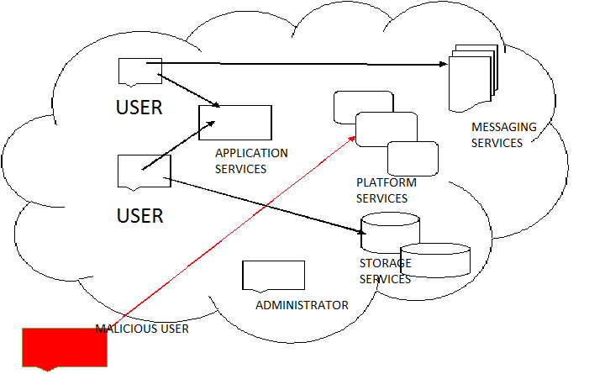
CREATION OF COMPANY ORGANIZATION ENVIRONMENT

Slide 9
CONTINUED
Configuring ESMTP
Here users are the configuring components of the ESMTP.
This is because the object of this thesis to protect the ESMTP by the dual wall protection methods.
Here the organization admin can create various users for their company, as well as they can able to share the group mails inside the group of companies.
These mails will not be stored in the junk mails, because these all are confidential mails handling in the ESMTP architecture.
Whenever the organization is created the default ESMTP will be assigned for both user and the company..

Slide 10
CONTINUED
Trust as a service
This is the core module in this project.
Here the system will be comes under a security zone for user monitoring.
There are three types of trust methods are used in this module namely IP synchronization, Data Synchronization and Time Synchronization.
As mentioned above these process will generate warning to the admin in case of any misbehaving activates of the employee.
This method will increase the trust level of the employee between the companies.
On time monitoring methods will be used here.

Slide 11
CONTINUED
Implementing Trust Routing Framework
In order to implement the trust routing framework, customized SMTP is needed.
So that here customization options of the ESMTP server will take place for providing the user rights.
After creating the user by the admin, admin can provide customized user rights to the users.
The customizations are customizing compose option, inbox, outbox, sent items and etc.
These rights can be given to all the users of this mail server.

Slide 12
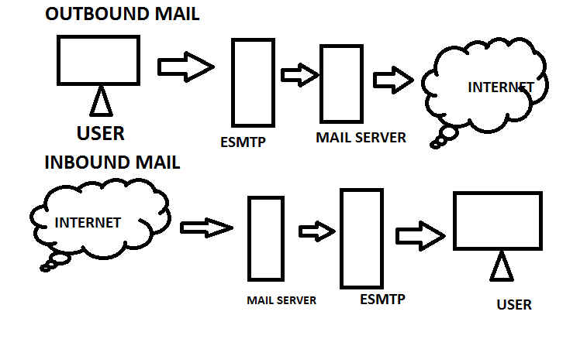
IMPLEMENTING TRUST ROUTING FRAMEWORK

Slide 13
CONTINUED
Implementing aware routing framework
In order to implement the aware routing framework here we are introducing IDS (Instruction detection system).
An intrusion detection system (IDS) is a device or software application that monitors network or system activities for malicious activities or policy violations and produces reports to a management station.
Intrusion detection and prevention systems (IDPS) are primarily focused on identifying possible incidents, logging information about them, and reporting attempts.

Slide 14
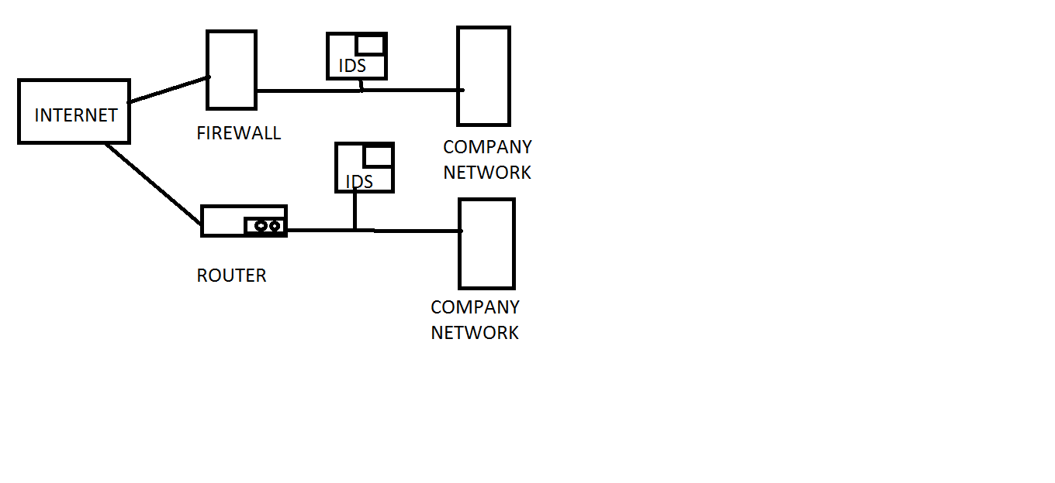
IMPLEMENTING AWARE ROUTING FRAMEWORK

Slide 15
ALGORITHM
ARMOUR ALGORITHM
INITIALIZATION:
IP – Internet protocol synchronization
DT - Date synchronization
TM – Time Synchronization
M – Mail
TR – Trust
ALGORITHM PROCESS
Start Process
User login from SMTP
DateTime DateTimeDiff (Mail M)
Get system date/time in SysDT
if (Received Filed is present in M) do
RecentRecDT=0
while (IP,DT, TM (M)) do (On condition)

Slide 16
CONTINUED…
Get date/time from Received Field in RecDT
if (RecentRecDT < RecDT) then RecentRecDT= RecDT
Calculate IP,DT, TM difference between SysDT and RecentRecDT in DTDiff
Return DTDiff
else if (Resent Filed is present in M) do
RecentResDT=0
while (EOF (M)) do
Get date/time from Resent Field in ResDT
if (RecentResDT < ResDT) then RecentResDT= ResDT
Calculate date/time difference between SysDTand RecentResDT in DTDiff
Return DTDiff else Get date/time from Send Date Filed in SenDT
Calculate date/time difference between SysDT and SenDT in DTDiff
Return DTDiff
Suggest trust
Stop Process

Slide 17
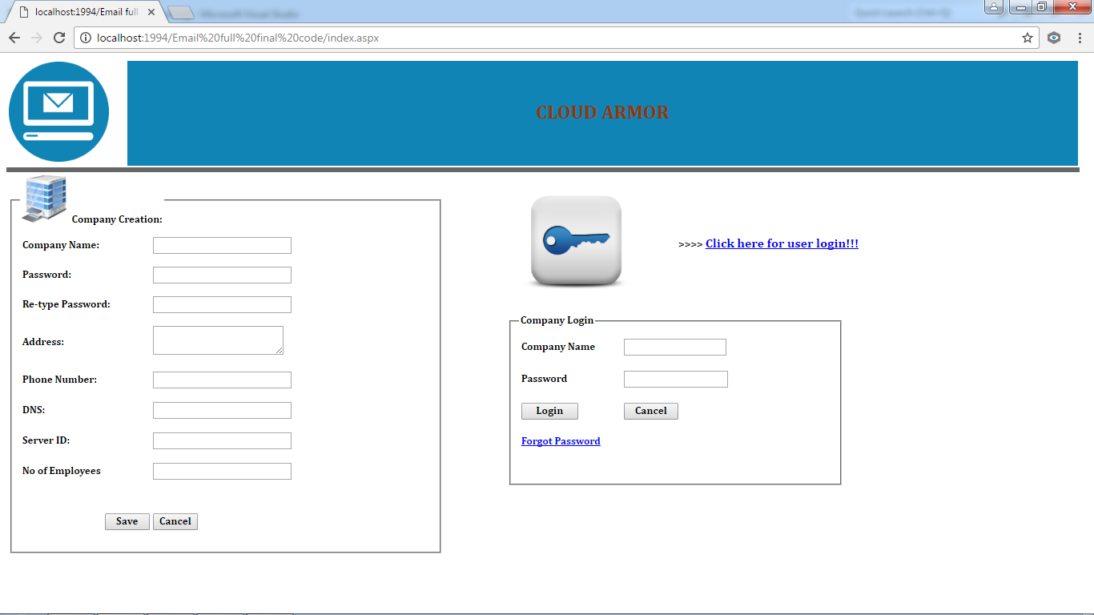
RESULTS
HOME PAGE:

Slide 18
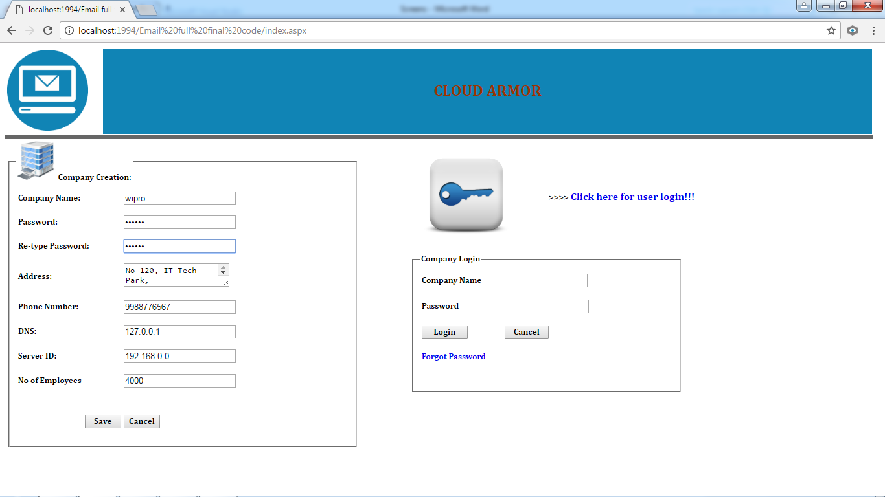
COMPANY CREATION WITH DATA:

Slide 19
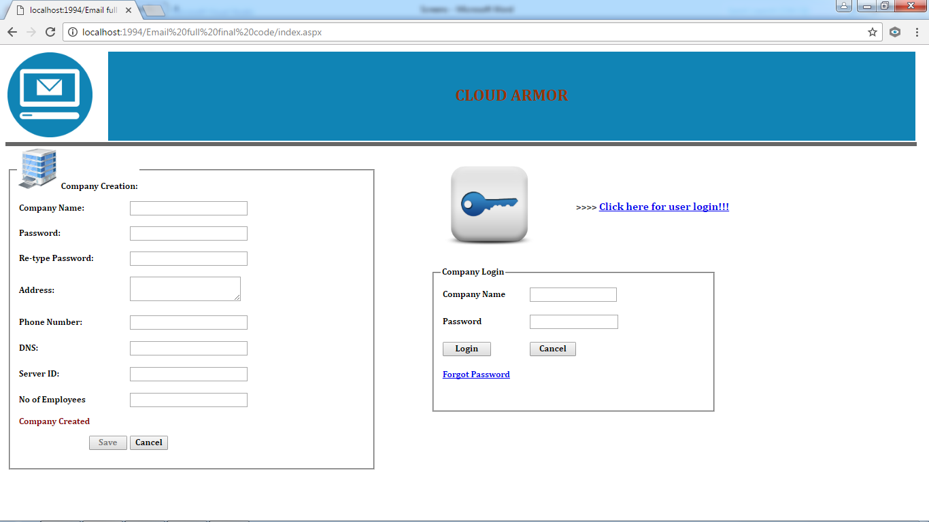
COMPANY CREATED ACKNOWLEDMENT:

Slide 20
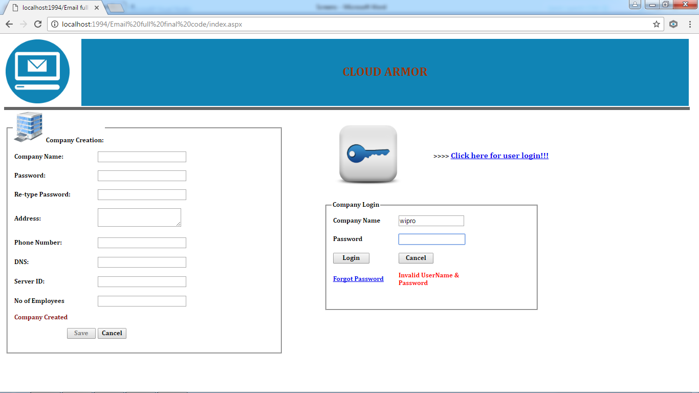
COMPANY LOGIN WITH INVALID USERNAME AND PASSWORD:

Slide 21
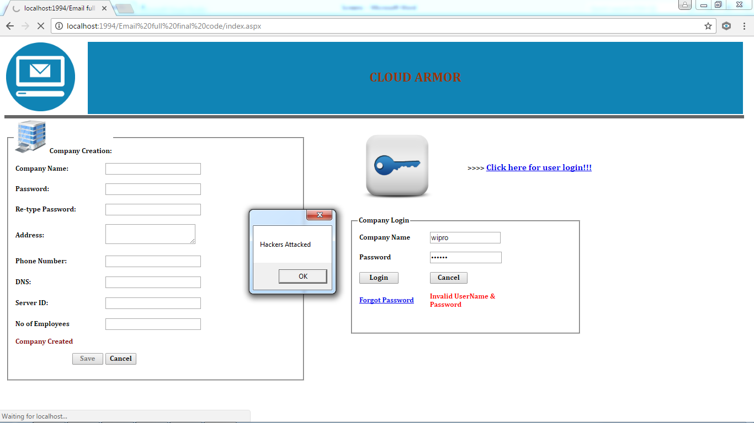
HACKERS ATTACKED ACKNOWLEDGEMENT:

Slide 22
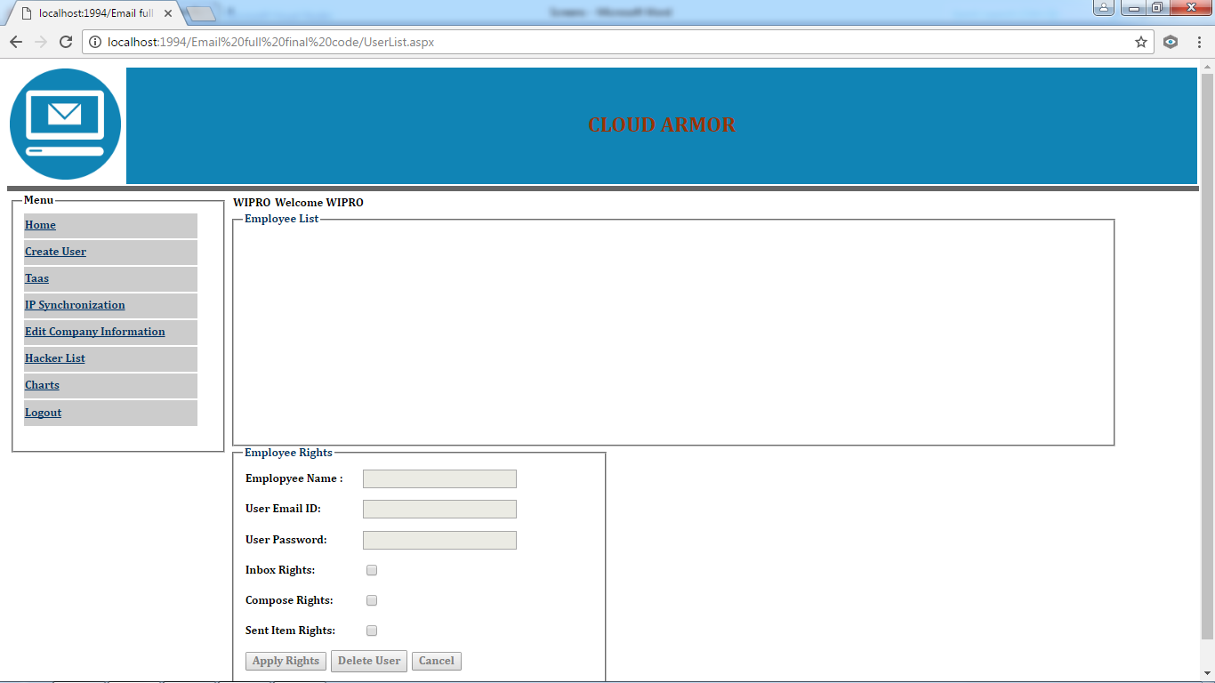
COMPANY HOME PAGE:

Slide 23
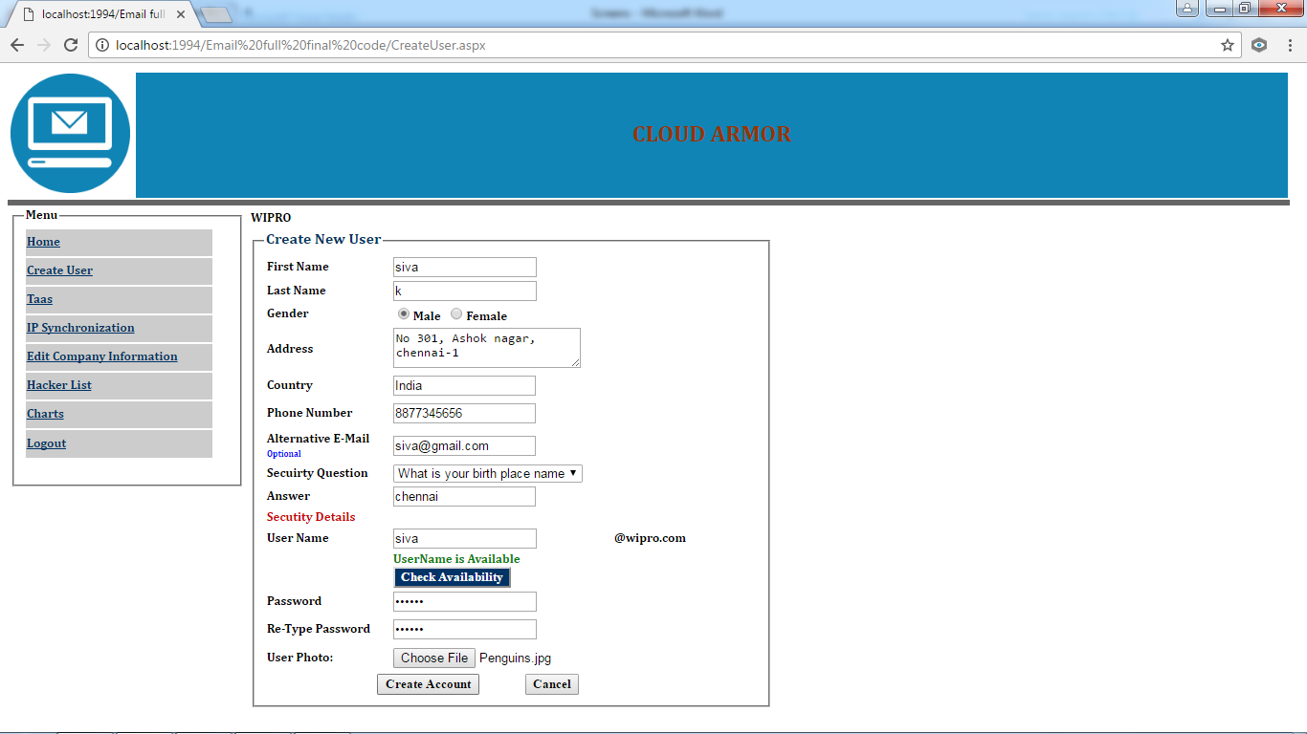
CREATE EMPLOYEE PAGE WITH THEIR DETAILS:

Slide 24
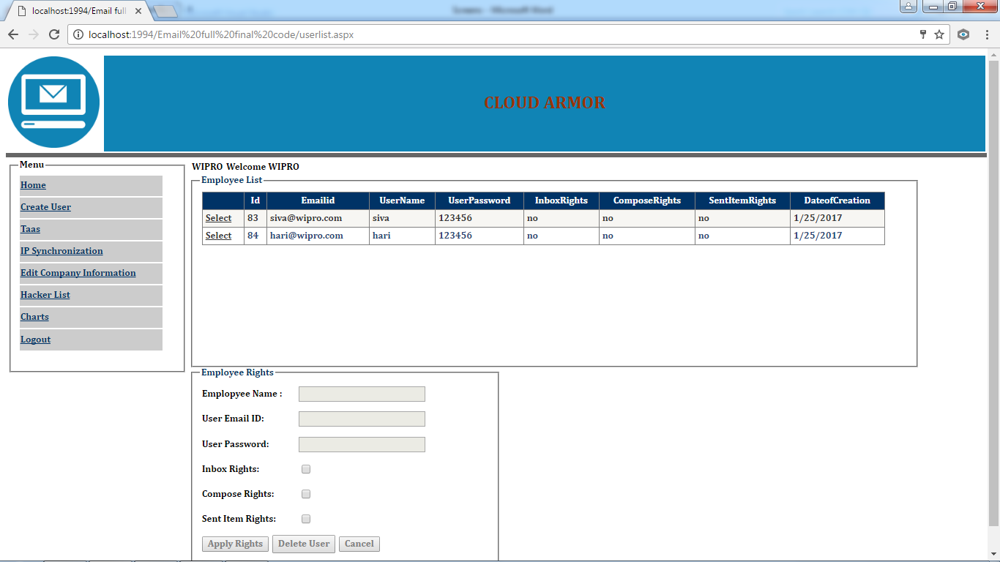
AVAILABLE USER LIST:

Slide 25
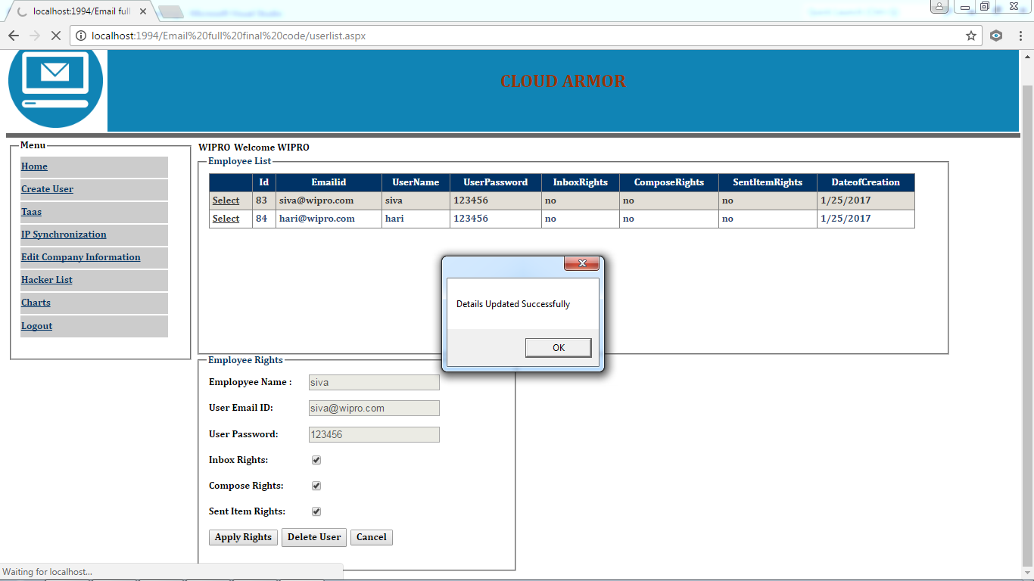
APPLYING RIGHTS FOR THE USER WITH
ACKNOWLEDGEMENT:

Slide 26
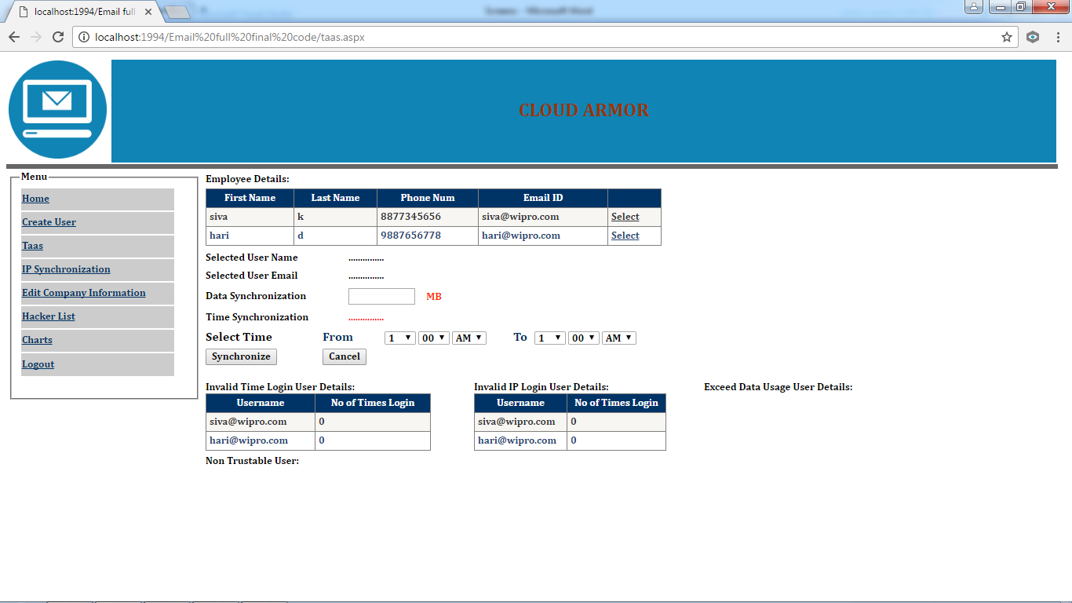
TRUST AS A SERVICE PAGE:

Slide 27
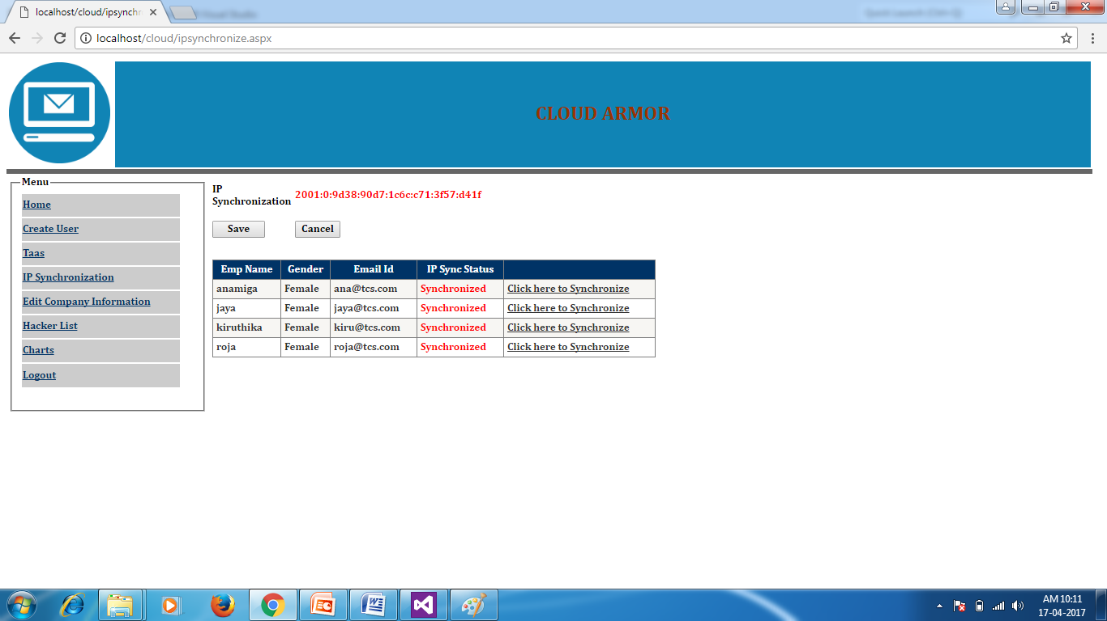
IP SYNCHRONIZATION

Slide 28
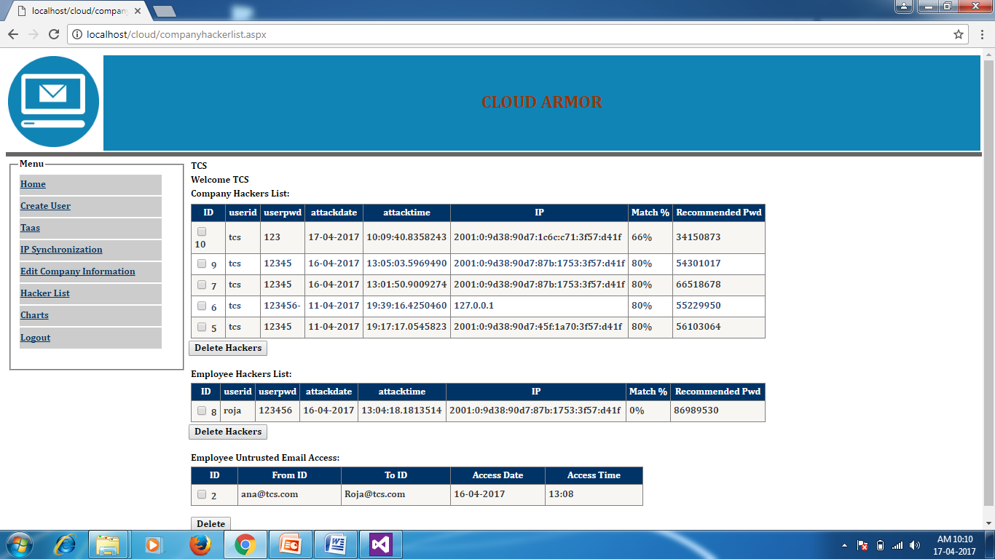
HACKERS LIST

Slide 29
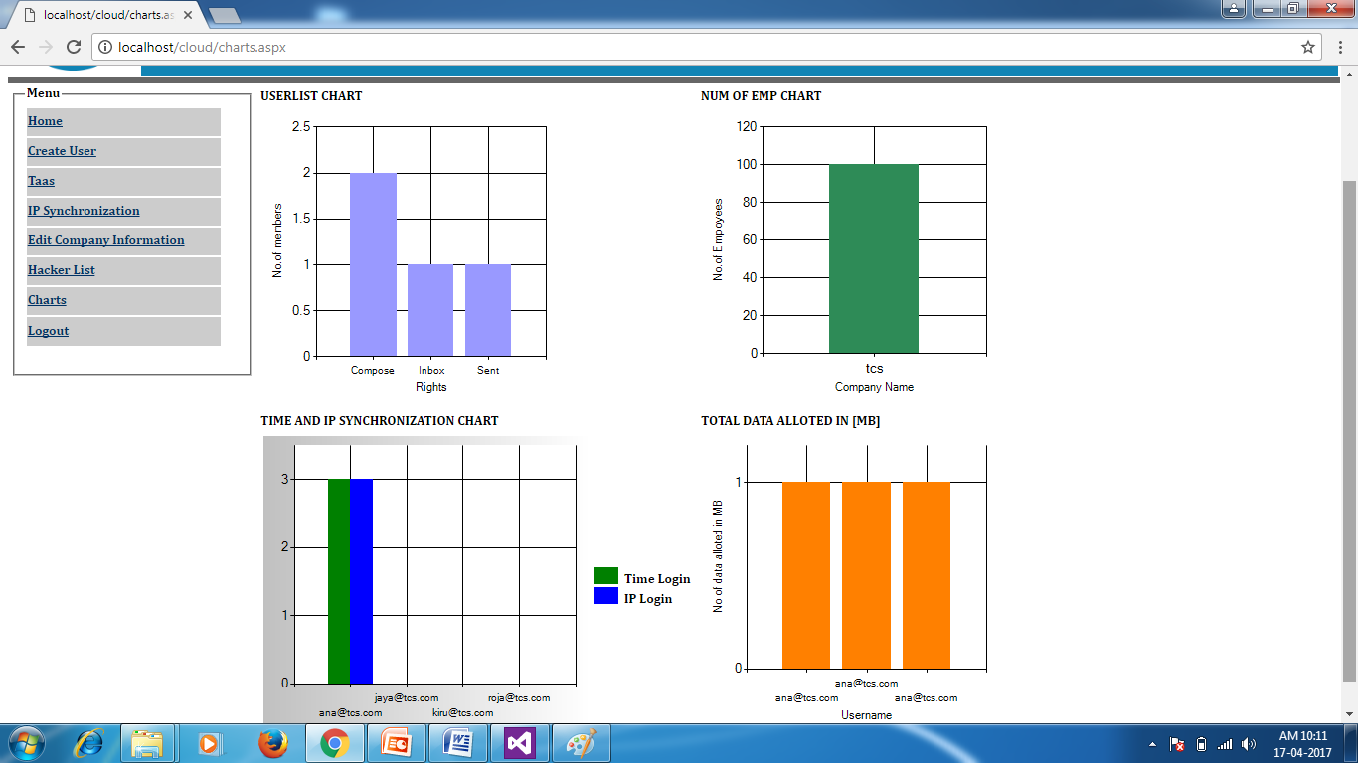
CHARTS

Slide 30
REFERENCES
Talal H. Noor, Quan Z. Sheng, Member, IEEE, Lina Yao, Schahram Dustdar, Senior Member, IEEE, and Anne H.H. Ngu, “CloudArmor: Supporting Reputation-based Trust Management for Cloud Services”, IEEE Transactions on Parallel and Distributed Systems, 2015.

Slide 31
THANK YOU

